Slide 1


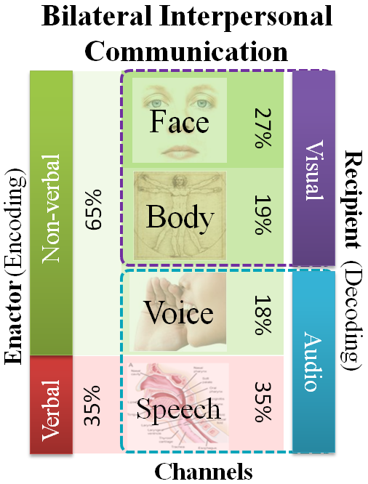
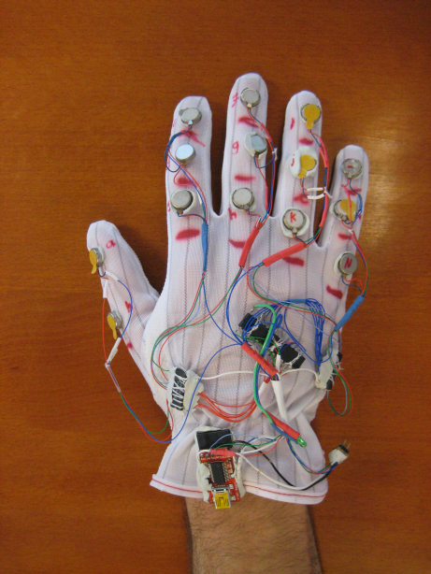

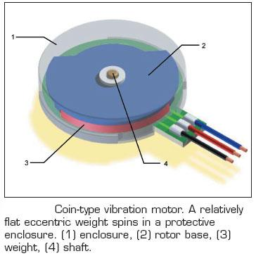
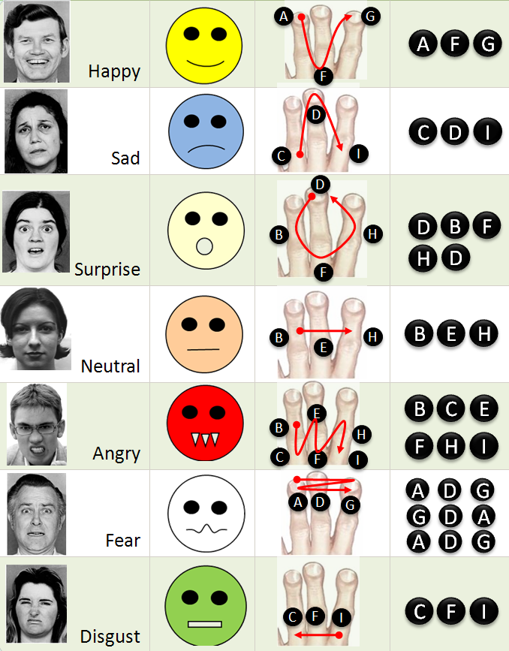
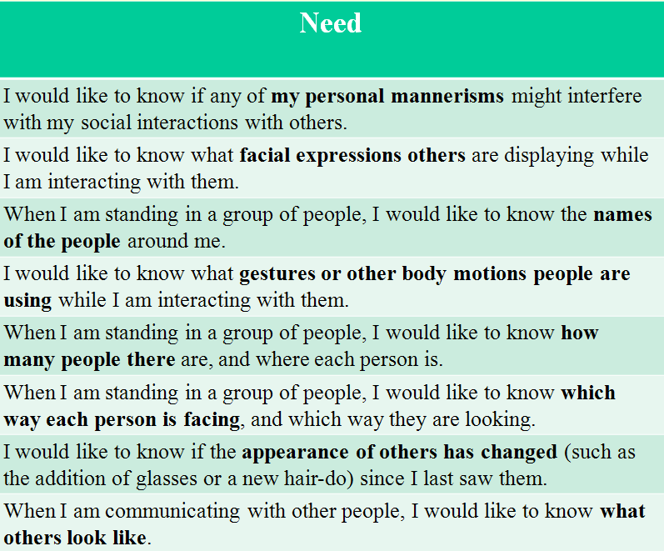
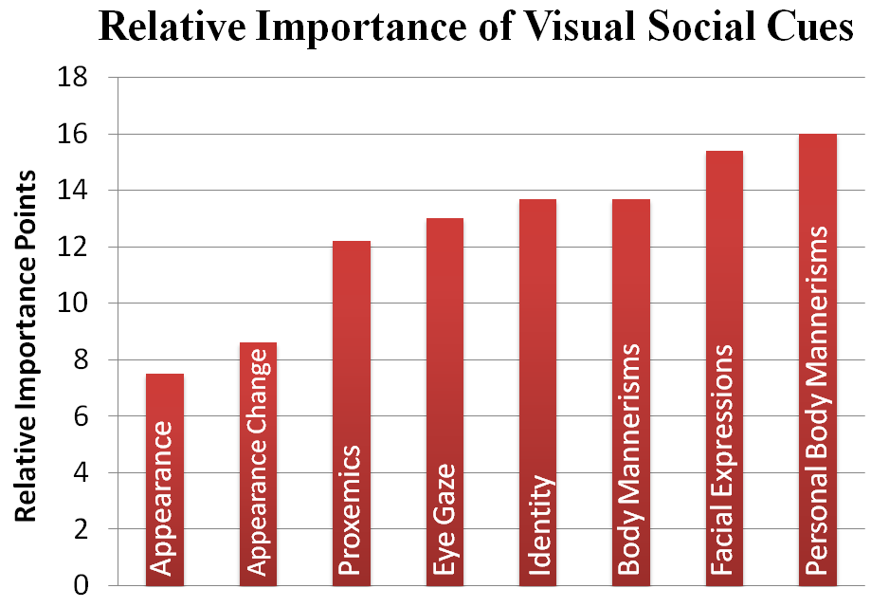
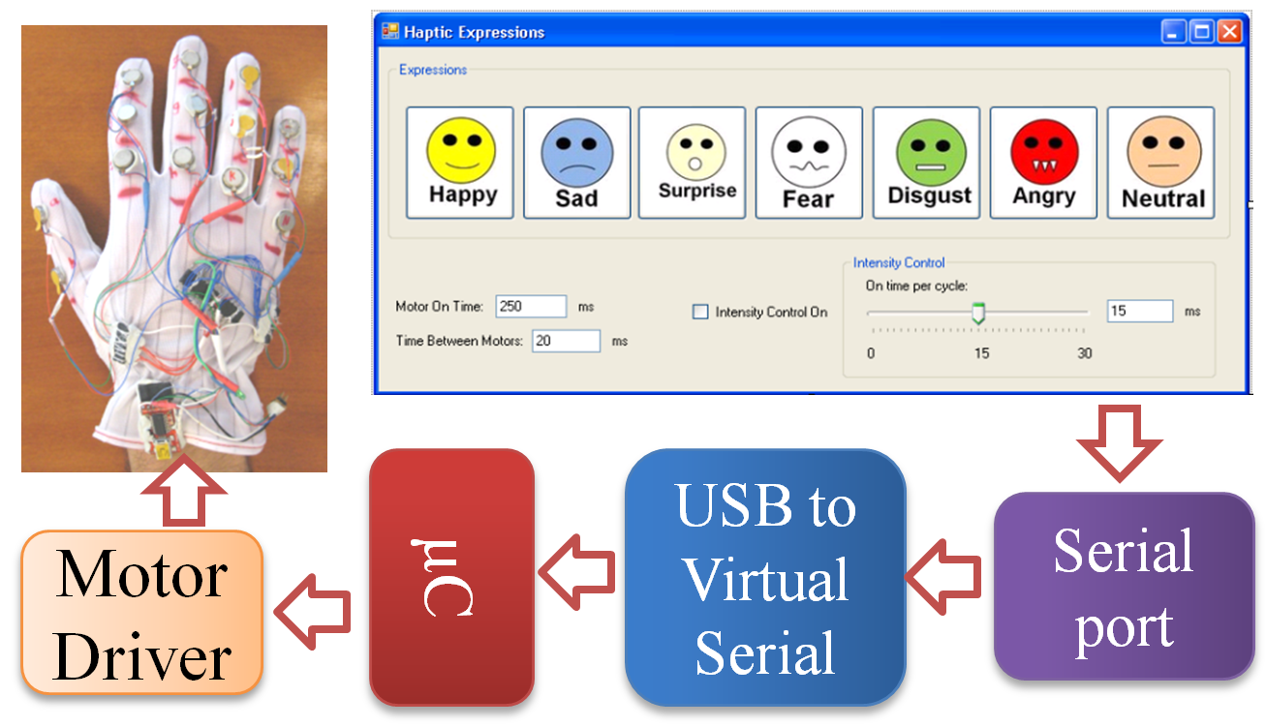
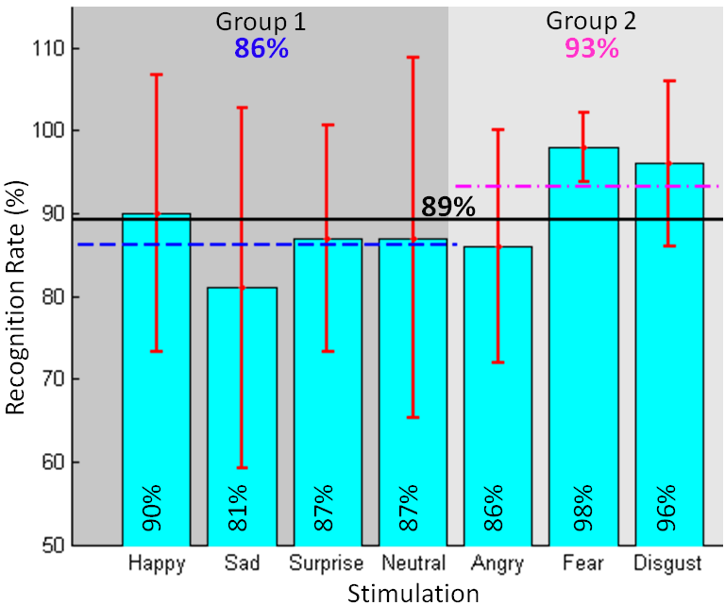
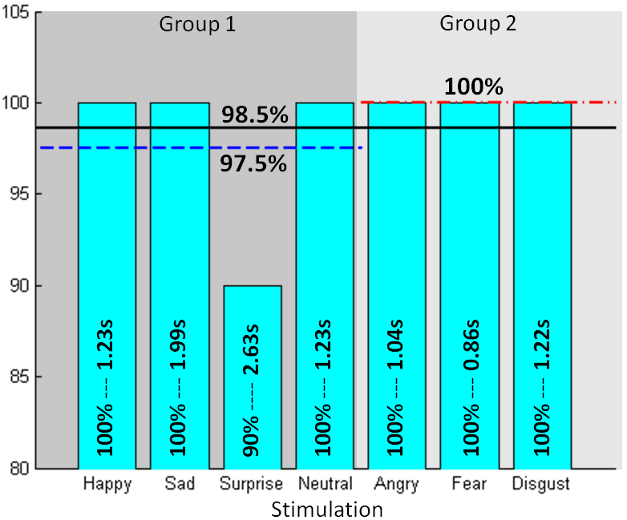
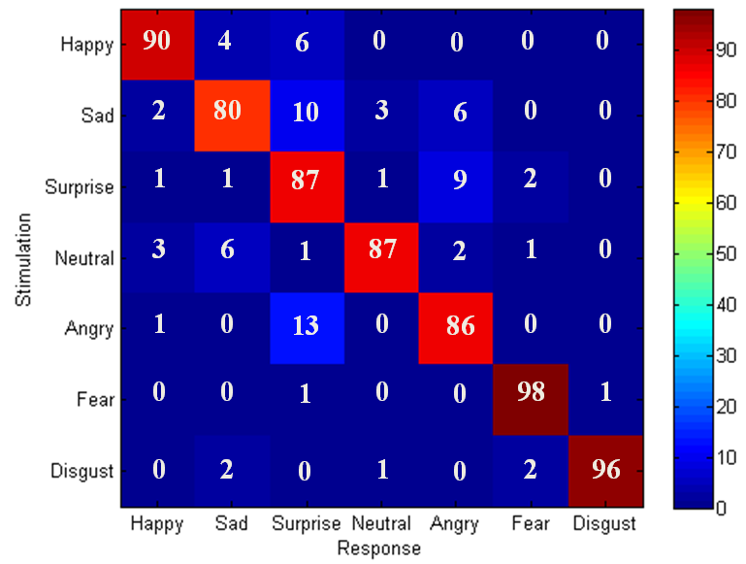
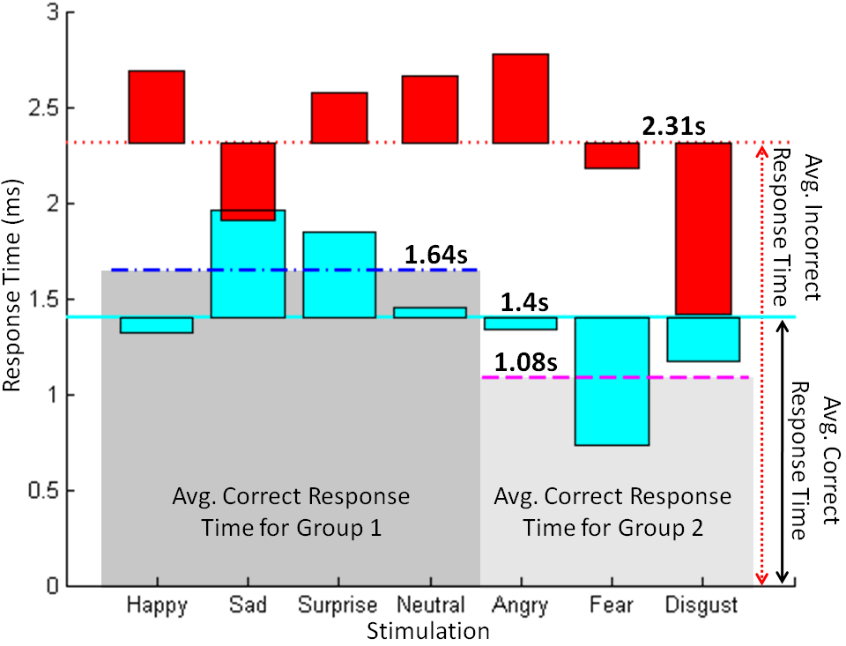
VibroGlove
An Assistive Technology Aid for Conveying Facial Expressions
Sreekar Krishna† , Shantanu Bala, Stephen McGuire, Troy McDaniel &Sethuraman Panchanathan
CUbiC Center for Cognitive Ubiquitous Computing
http://cubic.asu.edu
Motivation
Construction of Haptic Gloves & Design of Haptic Icons
Social interactions are an essence of healthy living.
Major portion of social interactions happen through non-verbal cues, especially visual cues.
People with sensory disabilities (persons who are blind or visually impaired) are at a loss when it comes to social interactions.
Assistive and rehabilitative aids could prove beneficial towards enriching personal and professional lives of individuals with disabilities.
Shaftless Vibration Motor
Hardware
The human face is very dynamic when it comes to generating important non-verbal communicative cues
Careful design considerations needed if face data has to be encoded on other modalities
In the target population there is a strong growing discomfort towards overloading their hearing
We explore vibrotactile cueing on the back of palm (hand has a large representation in the somatosensory cortex of the brain) to be versatile and unobtrusive
Atmel ATmega168 μC
Darlington Motor Driver
μC Programming Port
Important Visual Social Cues
USB-Serial Interface
Debug Port LED
Group 1
Software
Group 2
Based on two open ended focus groups conducted with persons with visual impairment
Based on online web survey conducted with 16 persons who are blind, 9 with low vision and 2 sighted specialists in the area of visual impairment
Goal: Design and Develop an human-human interaction enrichment tool that focuses on delivering facial actions of interaction partners to users who are visually impaired
Contact Info & Brochure
Contact Information
(3.5in x 2in)
Brochure
(8.5in x 11 in)
† Contact Author: Sreekar Krishna, Graduate Research Assistant, Center for Cognitive Ubiquitous Computing (CUbiC: http://cubic.asu.edu/), Arizona State University, Tempe, AZ. Ph: (480) 727-3612 Fax: (480) 965-1885 Email: Sreekar.Krishna@asu.edu

